Slide 1


Introduction
What is Psychology? How is Psychological Research Conducted?

Slide 2

What is Psychology? (1)
How would you define psychology?
  Study of mental illness?
  Therapy?
  Talking about problems/feelings?

Slide 3

What is Psychology? (2)
“Psyckhe” – breath, spirit, soul, mind
“-ology”/ “logos” – the study of…

Slide 4
Psychology Defined (1)
The scientific study of mental processes and behavior
  Psychology is a science, not a “psuedo-science”
    Uses the empirical method == gains knowledge through observation, logic, and reasoning
  Must be quantifiable (measurable), we can directly measure and observe behavior
  Infer unobservable mental processes
    Requires deep reflection, evaluation of evidence, and determining how (Critical Thinking)

Slide 5
What Psychology is not…
Psychology is not…..
  Reading minds
  Having everyone “figured out”
  The same thing as psychiatry
  Just common sense

Slide 6
Who are Psychologists?
Psychologists are scientists who study behavior and/or mental processes
  Many types of psychologists (clinical, behavioral, cognitive, etc.)
Work in many settings
  Private practices, academic settings, government research, etc.

Slide 7



Behavior Defined
For psychologists, behavior is any action that can be directly observed

Slide 8
Mental Processes Defined
Mental processes cannot be directly observed
  Thoughts
  Feelings and emotions
  Cognitive processes like memory and language

Slide 9
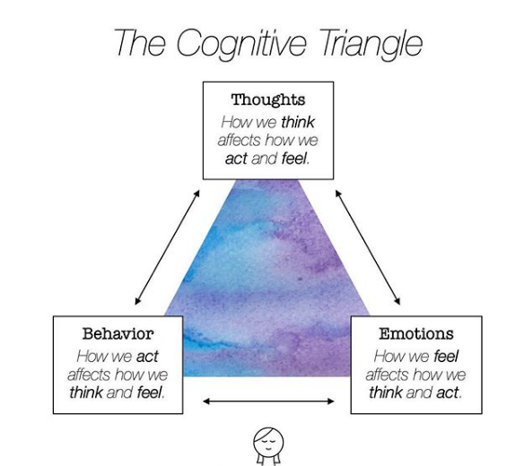

Slide 10
Thinking Like a Psychologist
Psychology is a rigorous discipline that tests assumptions
Relies on critical thinking, curiosity, and open-mindedness
Psychologists must be skeptical.
  Is a supposed fact really true?

Slide 11
Psychology as the Study of Human Behavior
What about mental illnesses?
Psychology includes the study of psychological disorders, but its only one piece of a larger puzzle
Stereotype that psychology is primarily focused on disorders

Slide 12
Why?
Psychological disorders are interesting
Media usually portrays psychologists as therapists or clinicians
History of the discipline
  Sigmund Freud and his fascination with “unconscious desires”

Slide 13
Contemporary Psychology Approaches
Psychodynamic
Behavioral
Humanistic
Cognitive
Evolutionary
Sociocultural
Biological
Multifaceted
Notes:
Stopped here!
QUIZ 1 ANNOUNCEMENT

Slide 14
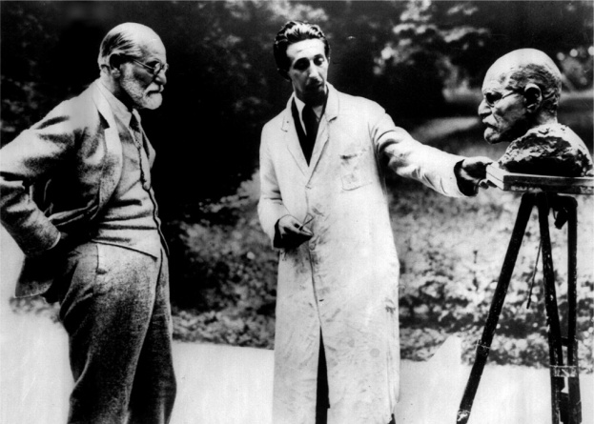
Psychodynamic Approach
Sigmund Freud
Psychoanalytic Theory
Emphasizes the importance of unconscious processes on personality, behavior, and goals
Psycho-sexual stages of development
  Childhood conflicts shape personality and behavior
  Based on individual case studies
  Most aspects of theory have been discredited
  Brought influence of unconscious thought to the fore!

Slide 15
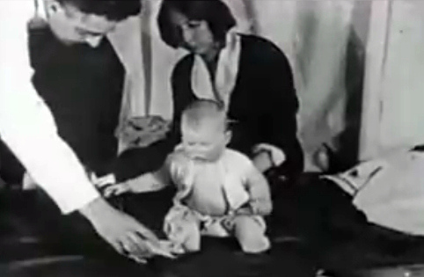
Behaviorist Approach
Objectivity and measurable behavior ONLY
Psychology should not be about mental processes, only observable behavior is suitable for study
  Mental experience is too vague for study
John B. Watson
  Founder of behaviorism
  Famous “Little Albert” experiment

Slide 16
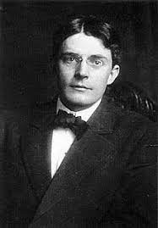
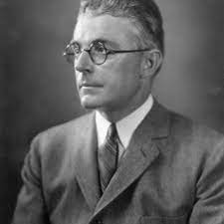
Behaviorism (1)
John Watson (1878–1958) - infants’ minds were essentially “blank slates”; argued that learning alone determines what people will become.
Nature vs. Nurture?
  Definitively nurture! The environment a child is raised is the only thing that matters to a behaviorist
  Thoughts?

Slide 17

Watson Quote

Slide 18
Humanistic Approach (1)
Psychology (esp. clinical) often paints a dark picture on human behavior
  Emphasis on maladaptive characteristics
Humanism – understanding the positive potential of human beings
  Humans have free will
  Human experience is variable
  Everyone has the potential for positivity, personal growth, pursuit of higher goals and achievements

Slide 19
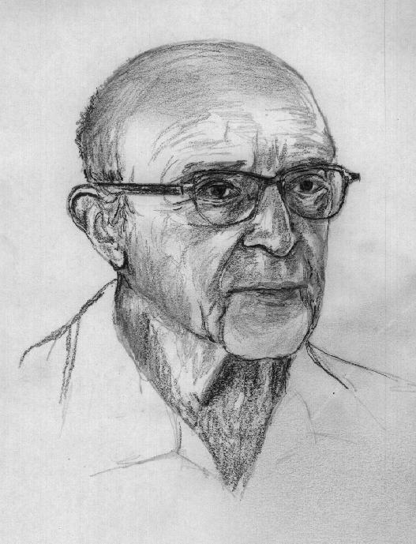
Humanistic Approach (2)
Carl Rogers
  Father of Humanistic Psychology
Client-Centered Therapy
  “Clients” vs. “Patients”
  All people have the capacity for personal growth
  Therapy needs to be tailored to maximizing personal growth, not trying treat and unconscious/unknown cause
  People can be rational
Positive psychology – Branch of psychology that emphasizes the inherent good in each person
  Growth, resilience, etc.

Slide 20
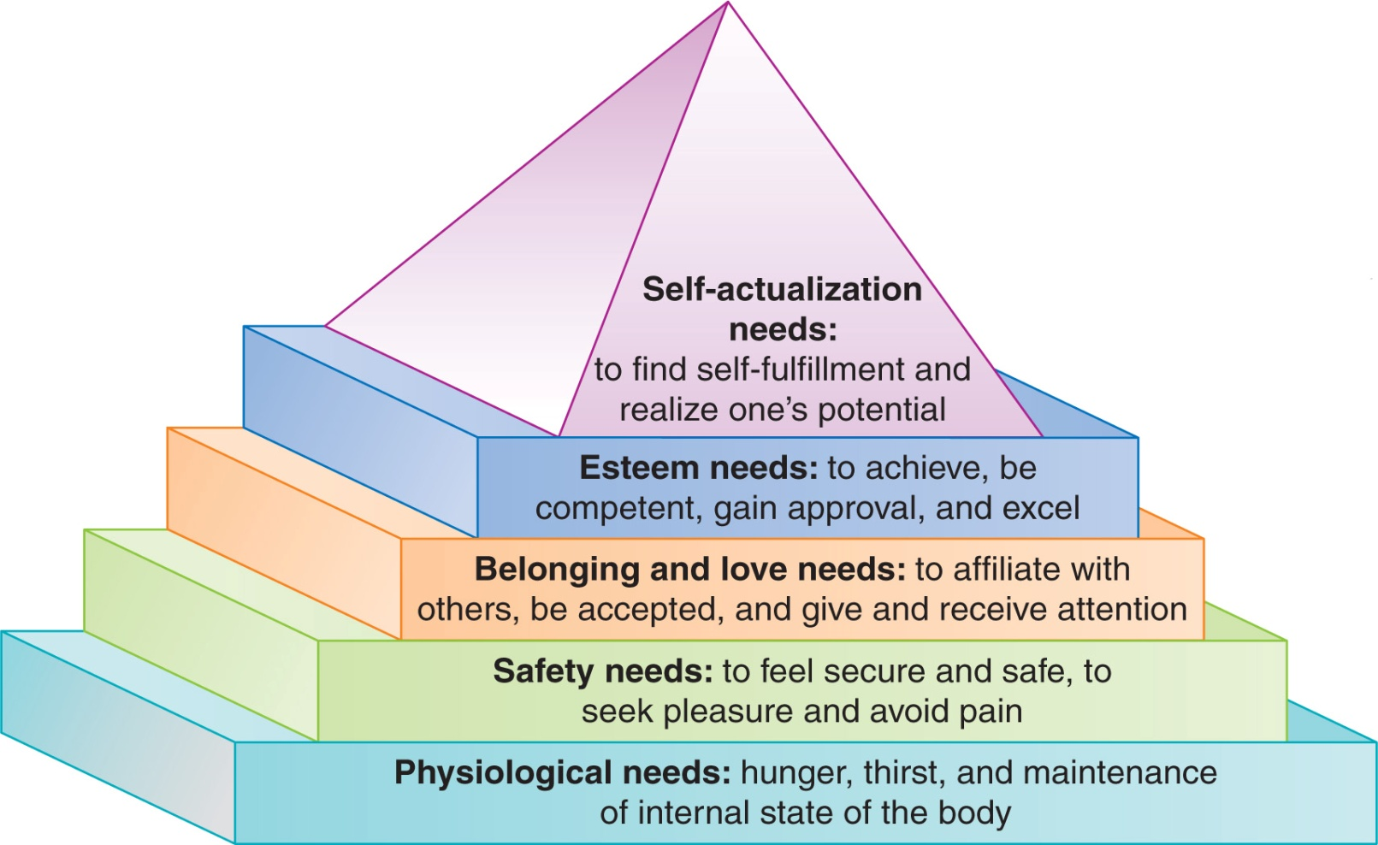
Humanistic Approach
Abraham Maslow

Slide 21

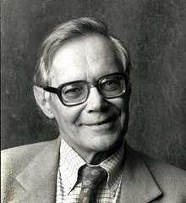
Cognitive Approach
Mental Processes
  The emergence of the computer (1950’s) sparked the cognitive revolution
  Departure from Behaviorism
  Computer Hardware = Brain/Nervous System
  Computer Software = Thoughts/Mental Processes
  We can control computer input, and measure output, not always clear what goes on internally (thoughts)
Revolution in 1960s

Slide 22
Cognitive Approach
Mental Processes
  The emergence of the computer (1950’s) sparked the cognitive revolution
  Departure from Behaviorism
  Computer Hardware = Brain/Nervous System
  Computer Software = Thoughts/Mental Processes
  We can control computer input, and measure output, not always clear what goes on internally (thoughts)
Revolution in 1960s

Slide 23
Evolutionary Approach
Evolutionary Psychology
  Explains the mind and behavior in terms of adaptive values of abilities that are preserved over time though natural selection
  Mental processes may also evolve
  Examples (why do we have these?):
    Emotions
    Mate selection
    Love
    Facial recognition

Slide 24
Sociocultural Approach
Sociocultural Psychology
  Study of how cultures reflect and shape psychological processes
  Culture –values, traditions, and beliefs shared by a group of people typically geographically related
  E.g., individualistic vs. collectivistic cultures

Slide 25
Biological Approach (1)
Linking brain and behavior
  Cellular Level
  Network Level
  Genetic Level
Interest in human behavior, though many experiments use animal models
Issue: Are animals a good proxy for humans?

Slide 26
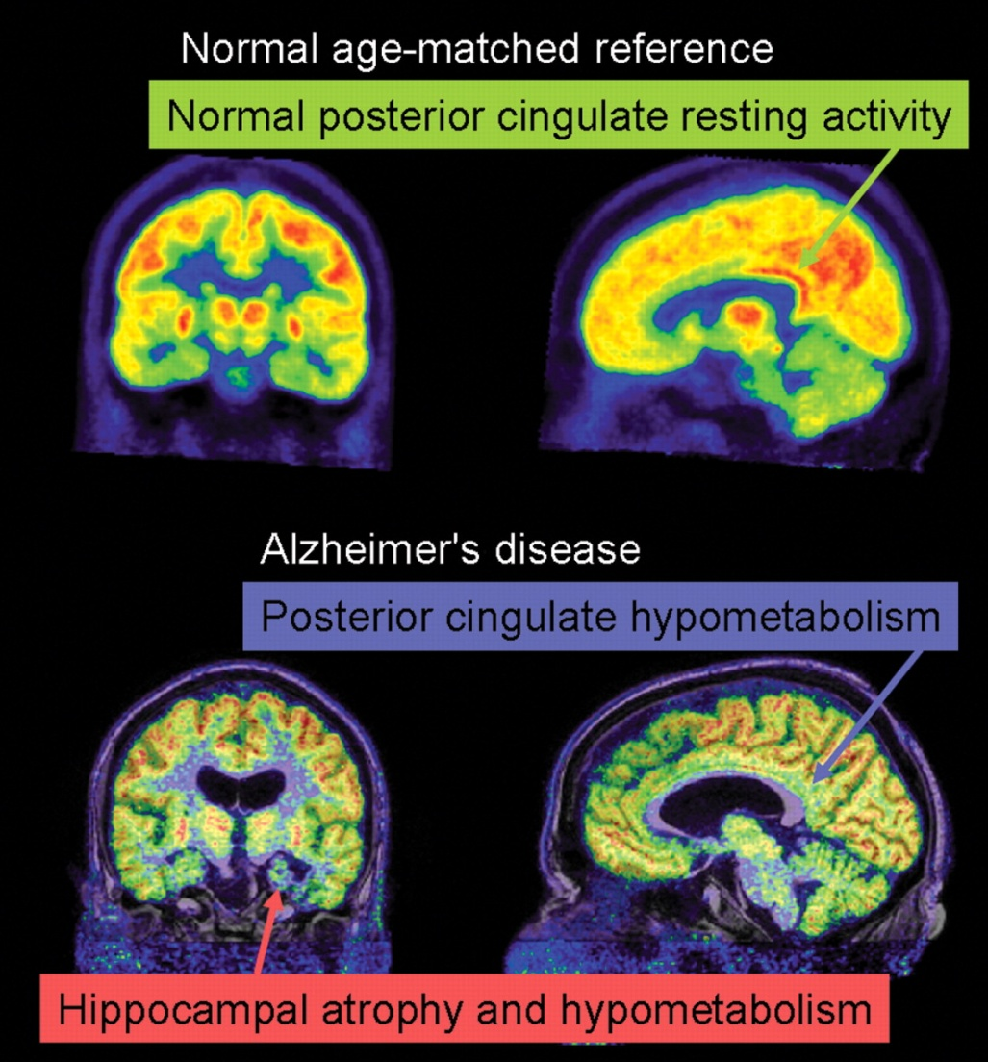
Biological Approach (2)
Cognitive Neuroscience
  Field of study that attempts to understand the links between the cognitive processes and brain activity
  Started in the 1980’s and has been booming since
  New technologies have advanced this area
    CT, MRI, fMRI, PET
  Relationships between brain structure and mental processes were found:
    Speech, language comprehension
    Memory
    Object recognition
    Neural Networks (Donald Hebb)

Slide 27

Summary of Different Approaches
Each approach provides a unique way to view behavior. Thus, each can produce valuable insights.
Aren’t necessarily competing approaches
Looking at this picture requires physical processes in the eyes (biological), knowledge of what a cat is (cognitive), you might smile (behavioral) or it could be due to unconscious memories of a childhood cat (psychodynamic)

Slide 28
Multifaceted Approach
No one approach is sufficient to account for all behavior
  Some better than others
A combination of approaches is key for understanding human behavior
Combinations are limitless
  Cognitive + Social + Biological (Social-Cognitive Neuroscience)

Slide 29
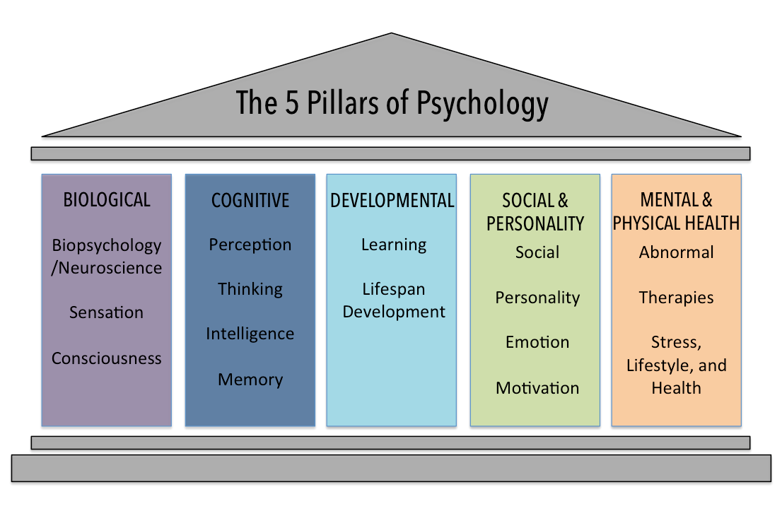
APA FIVE PILLARS
These “pillars” provide useful organization of research content areas

Slide 30
Themes Related to the Study of Psychology (1)
1. Psychology is Empirical
  Empiricism – knowledge should be acquired through observation
  Psychology uses the scientific method
    Ideas are tested, theories are developed and revised
  NOT based on speculation, or “common sense”
  “Bring me the data!!!”

Slide 31
Themes Related to the Study of Psychology (2)
2. Psychology is Theoretically diverse
  Theory – a set of related ideas used to explain observations
  E.g., Psychoanalytic theory – a theory about personality development/behavior development
  Competing points of view
    Theories must be tested within an empirical context
    Theory that best accounts for the data “wins”

Slide 32
Themes Related to the Study of Psychology (3)
3. Psychology Evolves in a Sociohistorical Context
  Emphasizes interconnections between what happens in psychology and what happens in society
    “Zeitgeist”
  Trends, issues, and values in society shape psychology
  Examples:
    Behaviorism – Based on the notion that mental events are too hard to study
    WWII – influx of clinical psychologists
    Presently – Factors that affect behaviors that increase/decrease disease transmission

Slide 33
Themes Related to the Study of Psychology (4)
4. Behavior is multi-causal
  Behavior is governed by a complex network of interacting factors that could contribute to the behavior itself
  Biological, Psychological, Social
    Biopsychosocial Perspective
    E.g., failing a test, eating disorders, depression/anxiety, suicide, etc.

Slide 34
Themes Related to the Study of Psychology (5)
5. Behavior is shaped by cultural heritage
  Culture – shared customs, beliefs, values, and norms by a group that are shared across generations
  Family roles, religion, attitudes
  Behavior in Western societies differs vastly from Eastern societies
    E.g., “Normal” vs. “Abnormal” depends on cultural contexts

Slide 35
Themes Related to the Study of Psychology (6)
6. Heredity and Environment jointly influence behavior
  Nature vs. nurture debate
  It’s not one or the other, it’s both
  The question has changed to “how much”
  E.g., personality, psychological disorders

Slide 36
Themes Related to the Study of Psychology (7)
7. An individual’s world experience is subjective
  People interpret and pay attention to the same information differently
  Experience of the world is shaped by interrelated factors
  Subjectivity makes the science of psychology difficult

Slide 37
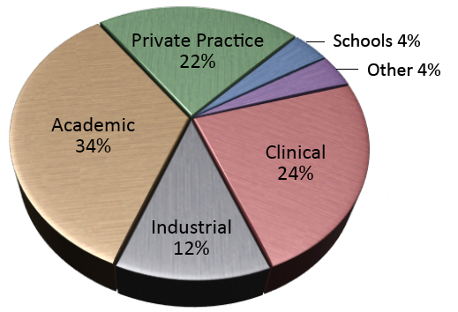
Careers in Psychology
Clinical Settings
Teaching
Research
Business Applications

Slide 38
Psychology is All Clinical, right?
FALSE!!!!!!
Forensic Psychology
Developmental Psychology
Women & Gender
Cognitive Psychology
Health Psychology
Learning
Clinical & Counseling Psychology
Physiological Psych / Behavioral Neuroscience
Social Psychology
Sensation and Perception
Personality Psychology
Community Psychology
Industrial / Organizational Psychology
Sport Psychology

Slide 39
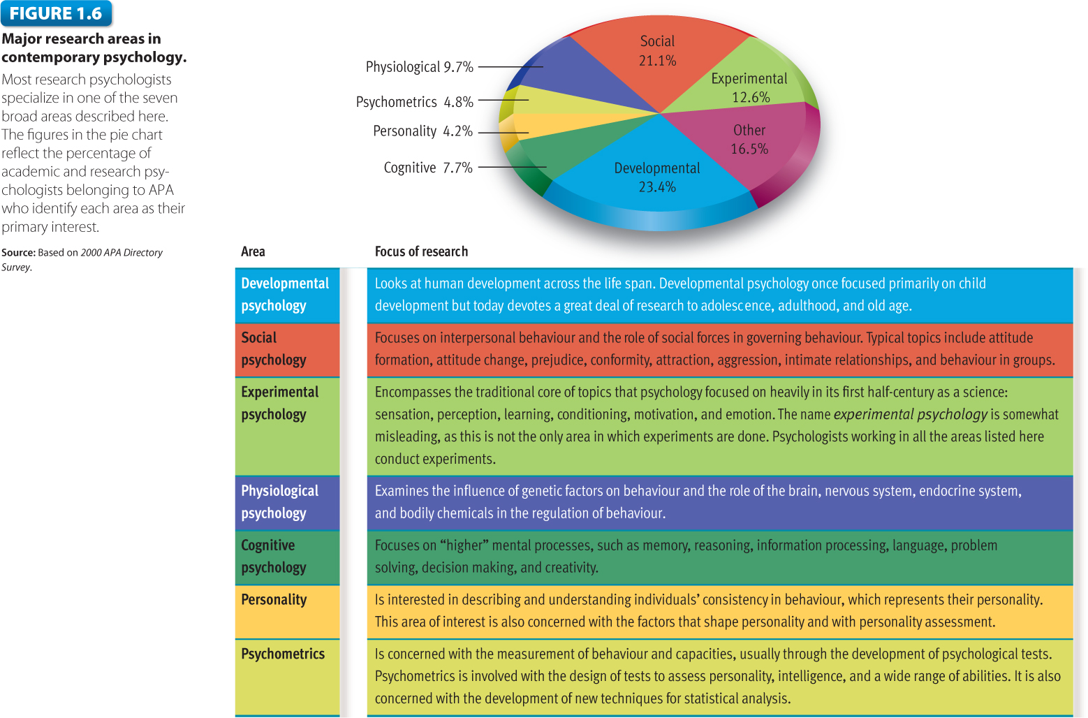
Careers in Psychology by Field

Slide 40
Educational Backgrounds in Psychology
Typical educational paths:
  B.A./B.S. Degree: 4 yrs
    Social work, case manager, career counselor, life coach
  M.A./M.S. Degree: B.S. + 2 years + thesis/license
    Research/Lab manager, drug/alcohol counselor (with licensure), Community College Instructor
  Ph.D. Degree: M.S. + 3-4 years + dissertation
    Clinical Psychologists, Primary Investigators, University Professors, Government Research
  M.D. Degree: Ph.D. + 2-3 years med school
    Psychiatrists, Neurologists

Slide 41
Questions or Comments so far?

Slide 42

Course Roadmap
Quiz 1 (due tonight! @11:59pm)
Next Week (8/30) – History of Psychology
Week 3 (9/6) – Research Methods in Psych
Week 4 (9/13) Exam 1

